Slide 1
Creating shareable Instagram-like Image Filters
Varun Agarwal
Zhongkun Xiang
Kamalanathan Sogathur Govindan

Slide 2
Introduction
Everyone loves clicking and sharing pictures, and
Everyone loves looking beautiful in them
Apps like Instagram run their business on this fact
The question is,
How can you create more beautiful looking pictures?
Instagram filters
Or any other image filters
Let’s see if it is really the case

Slide 3
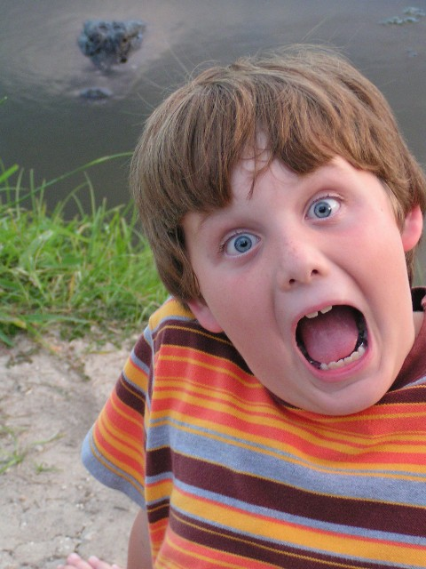
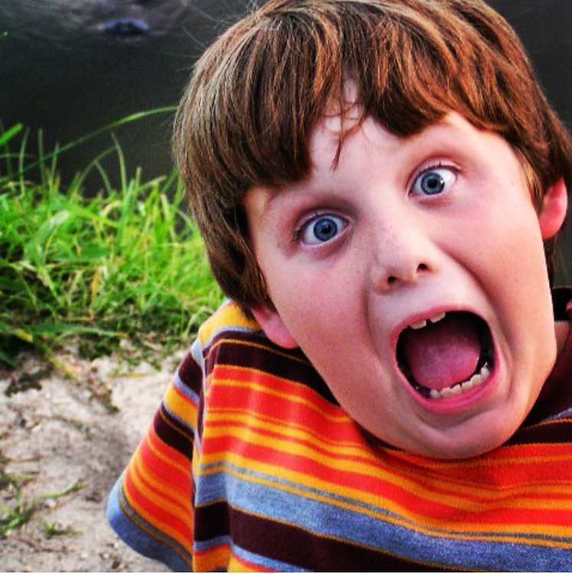
Original Image
Filtered Image (Lo-Fi)
Notes:
Looks like adding the filter does make the image look better. At least, we think so...

Slide 4
Concept
So, what are we doing, and why?
We want to help you make your own image filters through our conceptual application
And, be able to use them in apps like Instagram, Snapchat
And, be able to share them with your friends, so they can see your work
Notes:
So, where do we picture in?
We propose the concept of an application where you can go and make your own instagram filters, and be able to incorporate them into Instagram.
The solution we propose is making some third-party application that allows user to access an editor to perform more complex effect on an image.
If the user likes it, and wants to import this effect (filter) on Instagram or other social media platforms, the application will create a large number of random pixels with its relative position [R,G,B,X,Y], and apply the same effect on all these random pixels, and train a neural network that uses the original random pixels and filtered pixels as training and testing sets to learn the transformation (filter), and save the model as a filter
User may import such model to social media platforms as a filter

Slide 5

Concept
Create an application that has image transformation capabilities like,
Increasing/decreasing color in an image
Increasing/decreasing brightness of an image
Add vignette effect
And so on...

Slide 6
Concept
This is how someone would go about creating their own filter,
Upload an image on our app
What the user does
Perform a series of transformations on the image
Magical stuff happens in backend
What we do
Requires 3rd party integration in Instagram
Voila! New filter
What we get
User can possibly share filter on Instagram

Slide 7
Backend procedure
Train a neural network to learn the series of transformations
Save the model along with its weights, and share it with apps like Instagram
So, what’s the problem
User uploads one image, but neural network needs more than one to be trained
Two possible solutions
Apply same transformations to 1000s of random images from the internet
Apply same transformations on a synthetic/dummy data set that is representative of all combination of pixel values
We compared both of these methods to see which one performs better
Notes:
So, what is the magical stuff?

Slide 8

What are Image Filters?
Instagram filters are non-linear transformations on pixels in an image
Transformation of a pixel depends on,
Values of R, G, and B components
Relative position of pixel in the image
Transformation is independent of neighboring pixel values
Transformation can be thought of as a non-linear function of R, G, B values of the pixel, and X and Y values for the relative position
Our goal is to approximate this function using neural network

Slide 9
Methodology
Model architecture - Neural network with 2 fully-connected hidden layers
Input - R, G, and B value, & relative X and Y position of pixel (between 0 and 1)
NN takes in one pixel at a time
Output - Transformed (filtered) R, G, and B values of pixel
Essentially, neural network learns the filter
You pass an image to it, and it outputs the filtered version

Slide 10
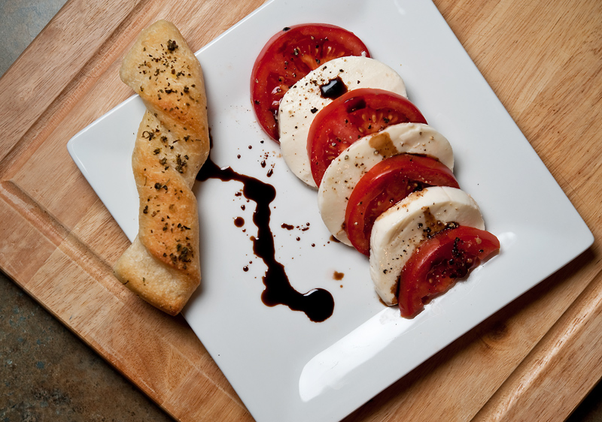
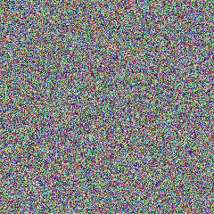
Methodology
We train the same model architecture with two training sets:
Set 1
Input is 1280 (240 X 240 X 3) actual images
Target is the same image with Earlybird filter applied on them
Set 2
1280 (240 X 240 X3) images with random values in pixels
Target is the same image with Earlybird filter applied on them

Slide 11
Results
Comparing the results of both the NNs
 | SSIM with NN trained on actual image dataset | SSIM with NN trained on synthetic/dummy dataset
Image 1 | 0.9113 | 0.9764
Image 2 | 0.8630 | 0.9672
Image 3 | 0.8342 | 0.9531
Image 4 | 0.8585 | 0.9691
Image 5 | 0.8252 | 0.9495
Notes:
After training both the NNs, we take 5 random images, and pass them through both the neural networks. Then, we compare the similarity of the output of these NNs with the ground truth Earlybird filter applied on the test images. The measure we use is SSIM (Structural Similarity). These are the results. It seems that … model has better results. We plan to further test both the models on more number of images to get a better estimate of which filter works better.

Slide 12
Future work
Learn more complex filters
Learn filters where pixel transformations also depend on adjacent pixels using CNNs etc.
Compression techniques to reduce size of the neural network
Construct algorithm to actually run the trained model (which is a filter) on Instagram etc.
Actually build an application around this proof of concept

